Slide 1



Data Professional Survey Breakdown
View in Power BI
Last data refresh:
2023/12/12 8:51:39 UTC
Downloaded at:
2023/12/12 9:27:30 UTC

Slide 2
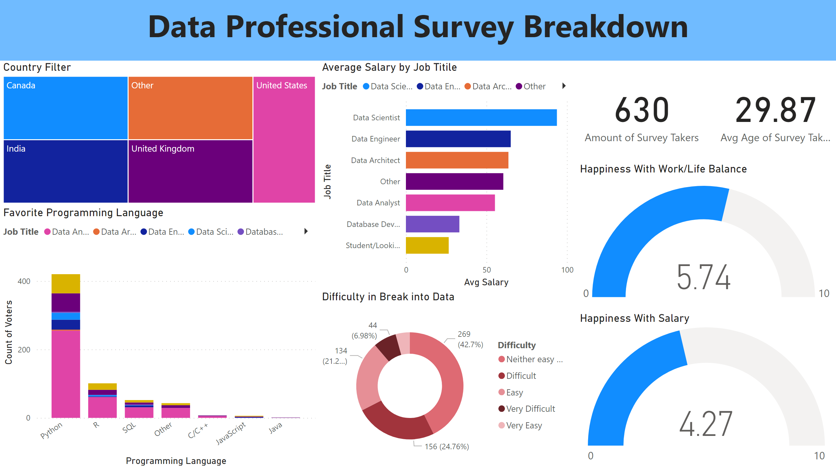
第 1 页
Notes:
textbox
No alt text provided
card
No alt text provided
card
No alt text provided
Average Salary by Job Titile
No alt text provided
Favorite Programming Language
No alt text provided
Country Filter
No alt text provided
Happiness With Work/Life Balance
No alt text provided
Happiness With Salary
No alt text provided
Difficulty in Break into Data
No alt text provided

